Slide 1

Use Cases of
GBM Pune innovation Lab

Slide 2

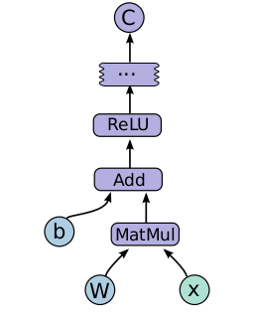
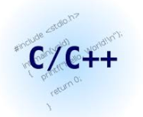

What is TensorFlow?
Google’s open source Machine Learning framework
Dataflow programming model. Represents,
Data as tensors, a typed multi-dimensional array
Computations as graphs
Nodes in the graph are called operations
Rich Deep Learning Algorithms
Accessible from
Notes:
In the graph displayed, edges are the tensors which is nothing but the data flowing from one node to another. Hence the name TensorFlow.
We have used Python API

Slide 3

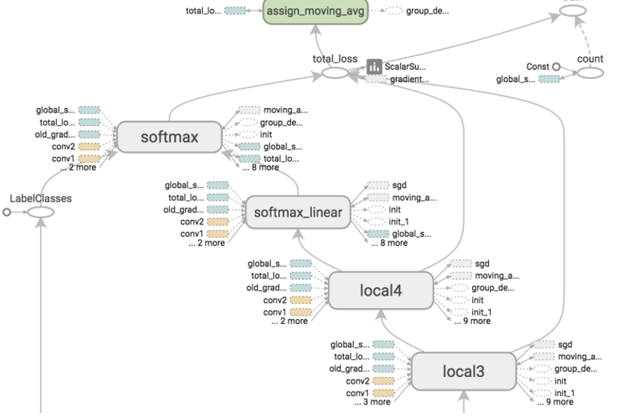
Why TensorFlow?
Easy to use
Distributed computing across different platforms with minimal code changes
Internals can be customized
Provision for using GPUs
Computational graph visualizations
Notes:
Documents are crisp and clear. We were able to create a model within few weeks.
When you create a model running in a single mode it could be made to run in distributed mode across different platforms such as Mobiles with very minimal code changes
If you’re a researcher and you want to try something crazy TensorFlow is the best option. You could have your own internal functions, for example Error metric.
A decade back GPUs are mostly used for Gaming. These days GPU plays a vital role in the field of ML as it reduces the running time by a larger extent.
TF has an utility called Tensor Board which provides visualizations of the graphs that you create. This comes handy when debugging your model.

Slide 4


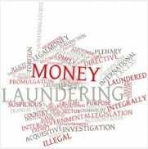
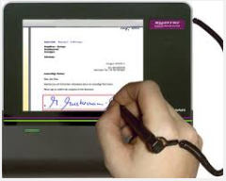

A Few Use Cases
Credit Risk
Document Classification
Anti Money Laundering
Signature Verification
Product Recommender System
HSBC Chat bot
Notes:
Credit Risk – Using the loan history data predict whether the customer will default on a loan or not. In other words, predicting whether it is safe or risky to loan the customer
Document Classification – Classify the documents based on their content.
AML – Cluster the wire transactions. This will filter out the anomalies using which the illegitimate transactions can be flagged. The current measures to prevent money laundering produces 95% false positive data. Using Machine Learning we could reduce the human efforts.
Signature Verification - Identify the signatures of various individuals and detect forgeries
Product Recommender System – Suggest products to the customers based on their portfolio
HSBC Chat bot – Customer care using AI. A bot that will answer users queries.

Slide 5
Credit Risk Model - Logistic Regression Model
1 – Safe
0 – Risky(Default)
y = wx + b
where,
y – Target/Output
x – Feature/Input
w - Weight
b - Bias
1
1
1
1
Salary
1
0
2Salary – Experience = 0
1
0
0
0
0
0
0
Experience
Test Accuracy – 67%

Slide 6
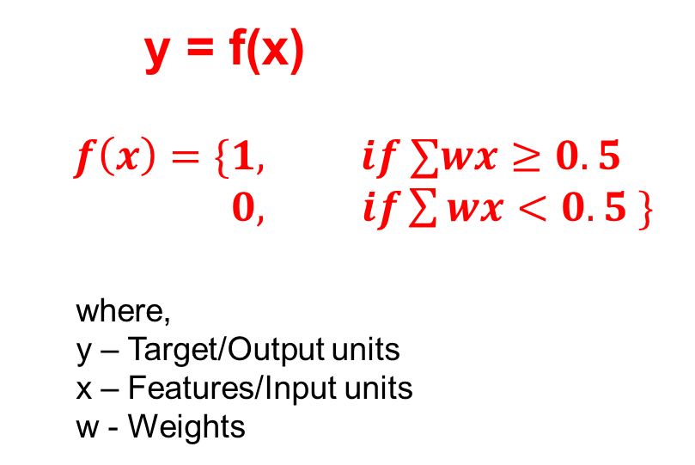
Credit Risk Model - Deep Neural Network Classifier
Hidden Layer
y = f(x)
$$f\left(x\right)=\{1, if ∑wx≥0.5$$
$0, if\sum{wx}<0.5 \}$
where,
y – Target/Output units
x – Features/Input units
w - Weights
x
y
Grade
1
Safe
Home
Ownership
0
Risky
Term
Test Accuracy – 80%
Validation Accuracy – 96%

Slide 7
Credit Risk Model - Demo

Slide 8
Queries
?

